Slide 1
FDM and TDM
Sources
https://www.linquip.com/blog/difference-between-fdm-and-tdm/
https://en.wikipedia.org/wiki/Multiplexing

Slide 2
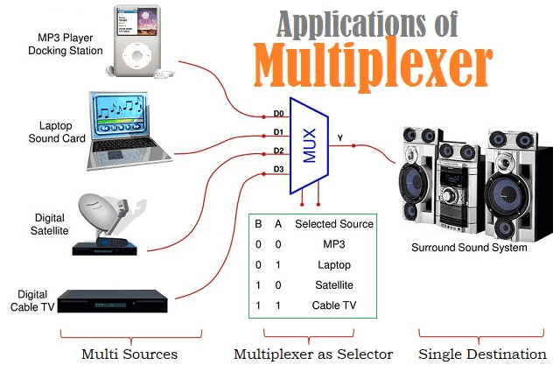
What is Multiplexing?
Multiplexing is a way of transmitting multiple signals through a channel. But the transmission of multiple signals is very challenging. But, the multiplexing technique makes it feasible.

Slide 3
Types
Analog Multiplexing
When multiple analog signals are combined into a single analog signal, the process is called analog multiplexing. The multiplexing is done according to their frequency or wavelength.
Multiplexing needs multiple signals to be kept separately in a way that they are not overlapped. This leads to separation at the endpoint. This goal is reachable by separating the frequencies of the signals.
Analog multiplexing itself is divided into two sub-categories: Frequency Division Multiplexing (FDM), and Wavelength Division Multiplexing (WDM). Among these categories, FDM is more popular.

Slide 4
Digital Multiplexing
Digital multiplexing refers to the operation of combining multiple digital signals into a single signal. The most well-known method of digital multiplexing is Time Division Multiplexing (TDM).
Applications of Multiplexing
Data transmission techniques based on multiplexing are widely used in sending communication signals. Below are some of these applications.
Multiplexing in satellites
Multiplexing in telemetry
Multiplexing in radio broadcasting
Multiplexing in telephone networks
Multiplexing in computer memories to carry the data from a memory location.
Multiplexing in TV broadcastings
Multiplexing in telecommunication systems
Multiplexing in video processing

Slide 5
Advantages of Multiplexing
The advantages of using multiplexing include the following:
The use of multiplexing reduces the complexity of the circuit and its components, decreasing the costs of the communication system.
This system makes optimal use of bandwidth.
A multiplexing system can pass several signals through one channel at the same time.
Challenges of Multiplexing
When transmitting data analog or digitally using a multiplexer, the signals must be synchronized.

Slide 6
What is Multiplexer?
The multiplexer is a circuit to shift analog, digital, or video signals as a combination system. It is a plain circuit that allows multiple analogs or digital data and combines them in a single signal and sends through the shared communication channel.
There are many types of multiplexers, some of which are listed here.
2:1 Multiplexer which consists of two signal inputs, one control bit, and one output.
4:1 Multiplexer which consists of four signal inputs, two control bits, and one output.
8:1 Multiplexer which consists of eight signal inputs, three control bits, and one output.
16:1 Multiplexer which consists of four sixteen inputs, four control bits, and one output.

Slide 7
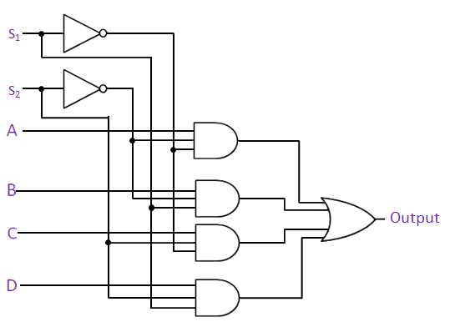
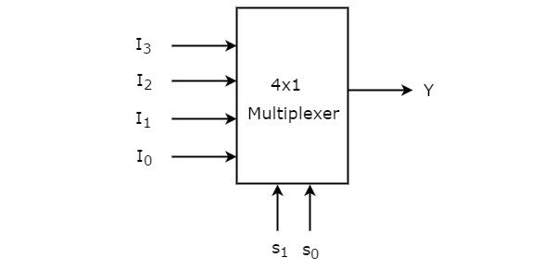
In the figure below, a 4:1 multiplexer block diagram is shown.

Slide 8
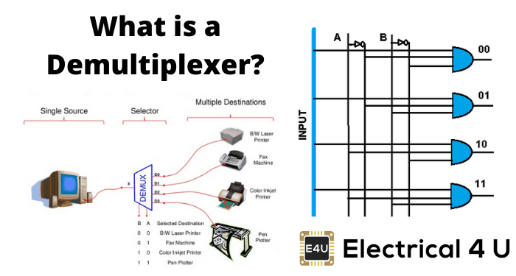
Demultiplexer

Slide 9
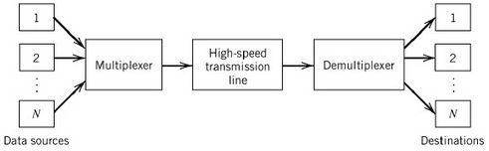
The concept of Multiplexer and Demultiplexer is illustrated in the figure below.

Slide 10
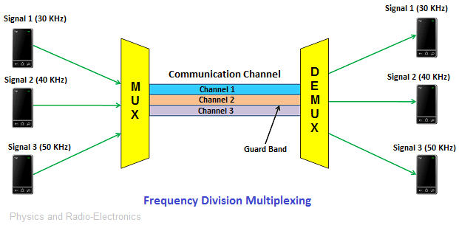
What Is FDM?
In telecommunications, FDM, which stands for frequency division multiplexing, is a system by which the entire ready bandwidth in a communication mechanism is arranged into a group of frequency bands that do not overlap. Each of them is responsible for transmitting a separate signal.
This provides a cable or optical fiber as single transmission media to be partaken by various independent signals.

Slide 11
How Does FDM System Work?
As seen in the figure, there are multiple transmitters at the endpoint at the transmitter, at the receiver end, there are multiple receivers. Between the transmitter and receiver, the communication channel is located to link the ends.
At the transmitter terminal, each transmitter gives a signal at different frequencies of 30, 40, and 50 Hz. These signals, which have different frequencies, are combined with a machine called a Multiplexer. This processed signal is then transmitted through a communication channel.
At the receiver terminal, the sent processed signals are again separated with the help of an apparatus called demultiplexer. Its application is to send the separated signals to different receivers. For example, in the figure above, each of the receivers, number one to three receives 30, 40, and 50 Hz, respectively.

Slide 12
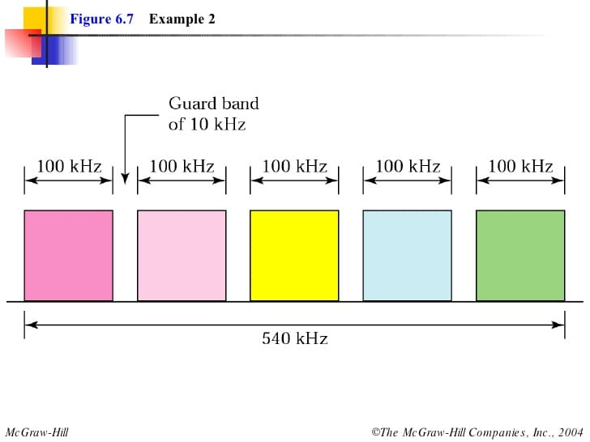

Slide 13
Applications of FDM System
Common applications of the FDM mechanism in communication media include the following.
Application of FDM in the first generation of mobile phones
Application of FDM in TV broadcasting
Application of FDM to broadcast FM and AM radio waves

Slide 14
Advantages of FDM System
These systems have some significant advantages listed below:
It is used to send multiple signals at the same time.
In this system, it is easy to demultiplex the frequencies.
There is no need for a process to synchronize the sender and receiver.
Disadvantages of FDM System
The drawback of these systems is the need for a large bandwidth linking channel.

Slide 15
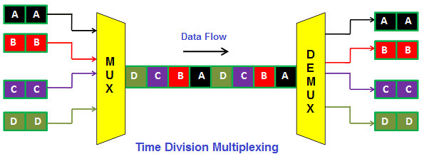
What Is TDM?
TDM or Time Division Multiplexing is a technique that allows several signals to be transmitted through one channel, one after the other. At the receiver terminal, the signals are separated and taken by the users. On this side, every user receives the corresponding signal at a different time.

Slide 16
Unlike Frequency Division Multiplexing where signals of different frequencies are transmitted together, in Time Division Multiplexing, signals are transmitted at the same frequencies but at different times.
In other words, channel sharing in TDM is a time-based system, unlike the FDM method in which channel sharing is based on frequencies.

Slide 17
How Does TDM System Work?
In TDM, each user as a receiver is assigned a specific time slot during which data frequency is transmitted. Each of these time slots is very small.
In a TDM system, not all signals are sent at the same time, and instead, they are sent sequentially. For example, in the figure above, signals A to D are sent in sequence, and thus each receiver allocates the bandwidth for a very short time.

Slide 18
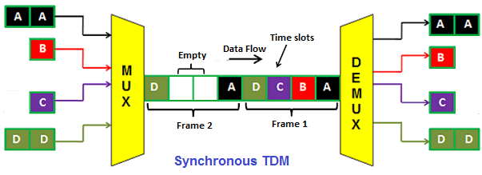
Synchronous TDM
In synchronous Time Division Multiplexing, all transmitters are assigned with fixed time intervals. The device must send data within the allocated time slot. Even if they do not have a signal to transmit, this time is assigned to them and in this case, the time slot of the device without data is empty.

Slide 19
In the figure above, you can see the time frames, each of which can contain several time slots assigned to the transmitters. Equal to the number of transmitters, we will have time slots within each time frame.
The above schematic figure is interpreted as having four transmitters, which in Synchronous TDM are assigned four time intervals per time frame. Also in the second frame, you see that devices B and C do not have data to send, so their space is empty but the time allotted to them remains in place.
The disadvantage of these systems is that the bandwidth is not completely employed and a portion of that is wasted.

Slide 20
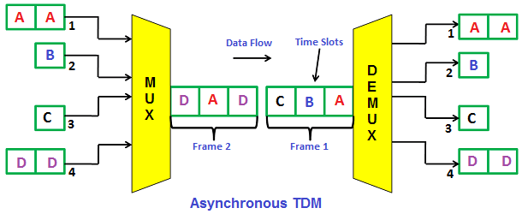
Asynchronous TDM
Asynchronous Time Division Multiplexing (also called statistical Time Division Multiplexing) is a multiplexing technique in which the time intervals are flexible and not fixed. In Asynchronous TDM, the number of time intervals and the number of transmitters are not equal, unlike the synchronous TDM. In asynchronous TDM, the number of time slots is less than the number of transmitters.

Slide 21
As shown in the figure, the number of time slots (3 in this figure) per time frame is less than the number of devices (4 in this figure). In the first time frame, the slots are occupied and the device that failed to send data in the first time frame (transmitter D) occupies the second time frame slots.

Slide 22
Applications of TDM System
The earliest uses of these systems in the telegraph.
Using TDM in cellular radios.
Using TDM in Satellite Access system.
Use of TDM in digital audio mixing system.
In GSM technology, TDM provides multiuser access by chopping up the channel into sequential time slices. Each user of the channel takes turns to transmit and receive signals. In reality, only one person is actually using the channel at a specific moment. This is analogous to time-sharing on a large computer server.

Slide 23
Advantages of TDM System
The TDM method is a more flexible technique than the FDM method.
In TDM, at a specific time, all the bandwidth is used by one user.
In TDM, the undesirable transmission of signals between communication channels occurs rarely.
Disadvantages of TDM System
A disadvantage of TDM over FDM is that TDM needs synchronization actions despite FDM which do not need.
TDM has lower latency in comparison with FDM.

Slide 24
TDM in GSM technology
TDM can easily adapt to transmission of data as well as voice communication.
TDM has an ability to carry 64 kbps to 120 Mbps of data rates.
TDM allows the operator to do services like fax, voice band data, and SMS as well as bandwidth-intensive application such as multimedia and video conferencing.
Since TDM technology separates users according to time, it ensures that there will be no interference from simultaneous transmissions.
TDM provides users with an extended battery life, since it transmits only portion of the time during conversations.
TDM is the most cost effective technology to convert an analog system to digital.

Slide 25
TDM vs FDM
 | FDM | TDM
How the Bandwidth Is Occupied | only one part of the bandwidth is always occupied by one signal | in sections of time, all the bandwidth is filled by one signal.
Signal Types | FDM can only work with analog signals. | works well with both analog and digital signals.
Flexibilities | the FDM system lacks flexibility and efficiency. FDM cannot adjust the width of the allotted frequency dynamically. | has more flexibility. it allocates more time slots to the signals requiring more bandwidth in a dynamic way, and besides, it reduces the time intervals for the signals that do not necessitate such a wide bandwidth.
Interferences | high in the FDM system. | low in the TDM
Efficiencies | FDM efficiency is relatively low because it is more prone to be faced with Interferences. | As the probability of interference in TDM is low, its efficiency is high.
Latencies | data transfer speed from source to destination is faster in FDM. data can be transferred at any time. So the latency in the FDM system is reduced. Thus in situations where the data transfer time is of paramount importance, FDM is used. | since there is a time slot assigned to each transmitter and there is only one channel for transmission, there may be a time delay (in the range of a few milliseconds) for the transmission of some data.
Constructions | more complex , the FDM technique is a more expensive multiplexing system than the TDM | TDM construction is simpler because of the type of wiring and chip
Required Inputs | guard band for FDM. | Synchronization pulse is necessary for TDM

